Slide 1
STOCK PRICE TRADING

Slide 2
CONTENTS
05
DECISION TREE
06
RANDOM FOREST STRATEGIES
01
INTRODUCTION
07
CONCLUSION
02
PROBLEM STATEMENT
03
EXPLORATORY DATA ANALYSIS (EDA)
04
LINEAR PREDICATION

Slide 3
What is Stock Price Trading?
What is Day Trading?
What is Long-term Trading?
What is Moving Average?
What are the types of Moving Average?
01
INTRODUCTION

Slide 4
What is Stock Price Trading?

Slide 5
Introduction
What is a Stock Market?
The stock market refers to public markets for issuing, purchasing, and selling stocks that trade over-the-counter or on a stock exchange. Stocks, sometimes known as equities, represent fractional ownership in a corporation, and the stock market is a marketplace for investors to buy and sell such investible assets.
What do you mean by Stock Trading?
Stock trading entails purchasing and selling company shares in order to profit from price fluctuations daily. Traders keep a close eye on these equities' short-term price changes and aim to buy cheap and sell high. Stock traders differ from regular stock market investors in that they focus on the short term.
What do you mean by Share Price?
A share price – or a stock price – is the amount it would cost to buy one share in a company. The price of a share is not fixed but fluctuates according to market conditions. It will likely increase if the company is perceived to be doing well or fall if the company isn’t meeting expectations.

Slide 6
Introduction
What is Day Trading?
Buying or selling an asset over a short period of time, such as seconds or minutes, is known as day trading. For instance, if the market price of a stock changes and a trader may profit from it, the deal is made. When day trading, all positions (buy or sale) are opened and closed on the same day. In the currency markets, there is no legal minimum capital requirement.

Slide 7
Introduction
What is Long-term Investment?
The word "long term" relates to how long an asset has been held. A long-term asset can be kept for as little as one year or as long as 30 years or more, depending on the type of security.
On the asset side of a company's balance sheet, a long-term investment account represents the company's investments, which include stocks, bonds, real estate, and cash. Long-term investments are assets that a corporation plans to keep for at least a year.

Slide 8
Introduction
What is Moving Average?
A moving average is a technical indicator that market analysts and investors can use to figure out which way a trend is going. It averages the data points of a financial security over a given time period by multiplying the total by the number of data points. Because it is constantly recalculated based on the most recent price data, it is called a "moving" average.

Slide 9
Introduction
Types of Moving Average:-
Simple Moving Average:
The simple moving average (SMA) is a simple technical indicator that is calculated by adding up all of the recent data points in a collection and dividing the total by the number of time periods. The SMA indicator is used by traders to generate tips about when to enter or quit a market.
Exponential Moving Average:
Exponential moving average (EMA) gives more weight to the most recent price points to make it more responsive to recent data points. An exponential moving average tends to be more responsive to recent price changes, as compared to the simple moving average which applies equal weight to all price changes in the given period.

Slide 10
Introduction
ALMA
The ALMA Data Mining Toolkit (ADMIT) is a value-added Python software package which integrates with the ALMA archive and CASA to provide scientists with quick access to traditional science data products such as moment maps, as well as with new innovative tools for exploring data cubes and their many derived products. The goals of the package are to:
make the scientific value of ALMA data more immediate to all users
create an analysis infrastructure that allows users to build new tools
provide new types of tools for mining the science in ALMA data
increase the scientific value of the rich data archive that ALMA is creating
re-execute and explore the robustness of the initial pipeline results.

Slide 11
Problem Statement

Slide 12
Problem Statement
We are trying to design a model that can predict stock prices, and determine if we should buy or sell using different methods and algorithms such as:
1. Exploratory data analysis (EDA) of our Dataset.
2. Linear Prediction
3. Decision Tree
4. Feature Scaling
5. Random Forest

Slide 13
Problem Statement
Dataset and Libraries Used
We are using the Dataset by Yahoo finance (yfinance) for stocks price to this day.
We had to used different libraries for the purpose of our project, such as:
Pandas
Numpy
Sklearn
StocksMethods
ALMAIndicator
For the Purpose of Visualization, we are using the in-build libraries such as:
MatplotLib
Seaborn

Slide 14
Exploratory Data Analysis (EDA)

Slide 15
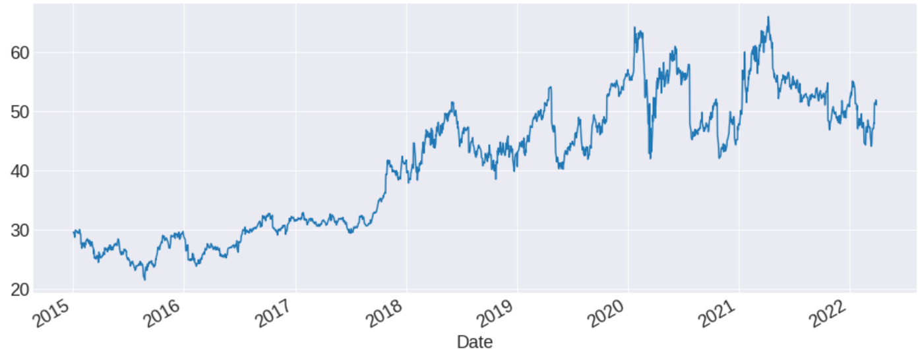
EDA
The following output shows the Adjacent closing price after adjustments for all applicable splits and dividend distributions from the year 2015 to 2022.

Slide 16
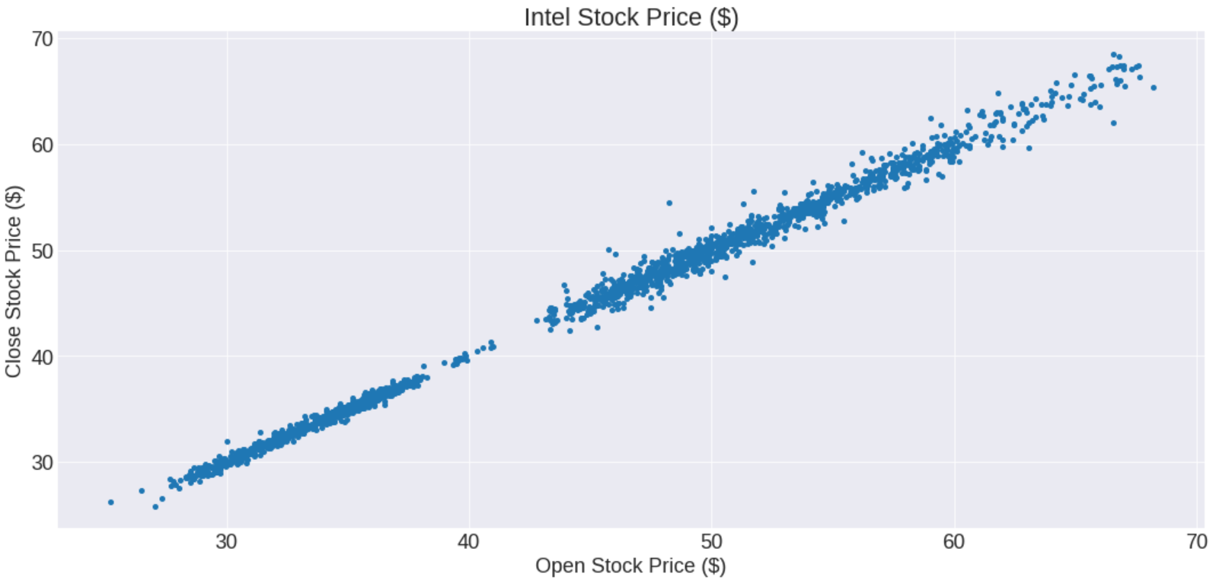
EDA
The following graph represents an EDA of the opening and closing time of Intel Stock Price

Slide 17
Linear Prediction

Slide 18
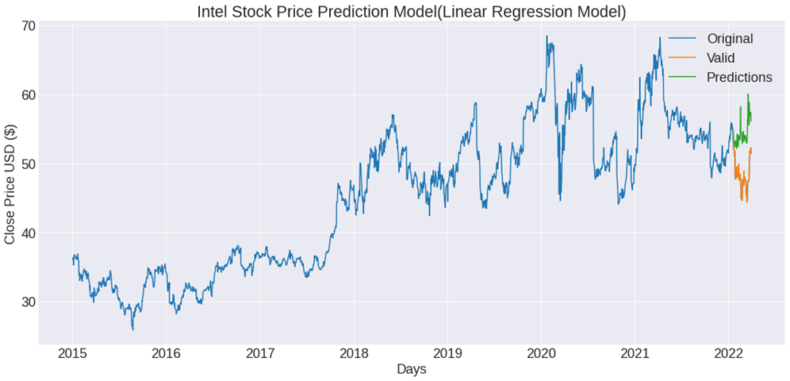
Linear Prediction Model
Model demonstrates 50 days prediction
Model compares actual value where stocks closed
And where they were predicted to close.

Slide 19
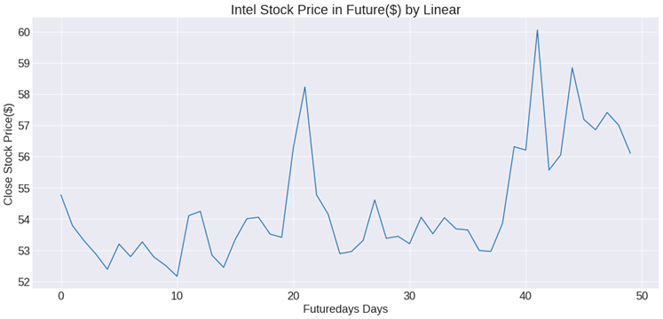
Linear Prediction Model
Linear Model depicted on a matplotlib graph.

Slide 20
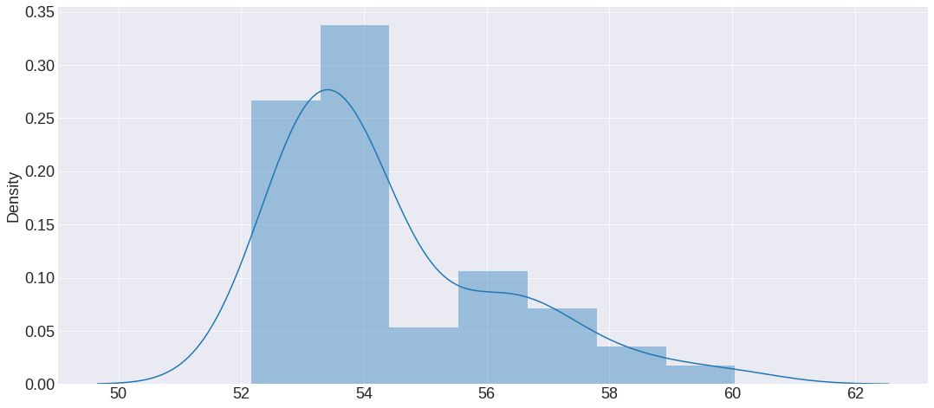
Linear Prediction Model
These graphs are a comparison between the actual values and the predicted values using Linear Prediction Model
Notes:
These charts are illustration of how our predictions ……. The first chart on the top left indicates…… followed by the….. Our prediction was proven false ……Results of data

Slide 21
Decision Tree

Slide 22
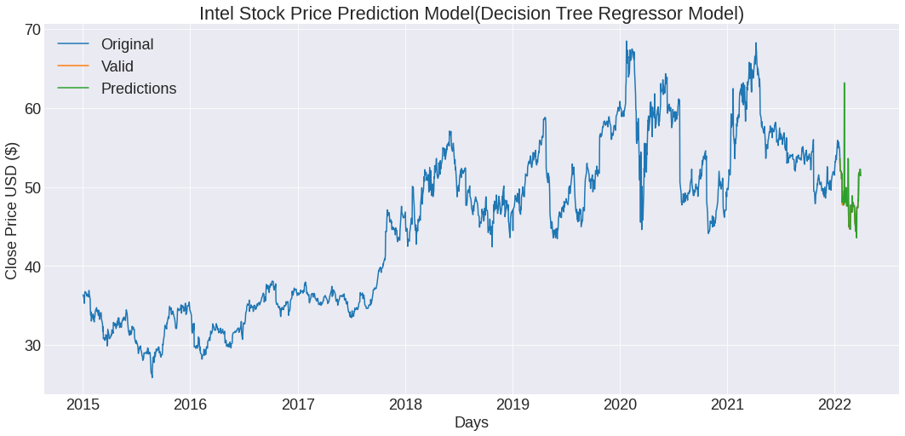
Decision Tree Model
This graph Depicts the Decision Tree Model.
Demonstrates the actual stock prices and predictions are more accurate than the Linear Prediction Model
Notes:
These charts are illustration of how our predictions ……. The first chart on the top left indicates…… followed by the….. Our prediction was proven false ……Results of data

Slide 23
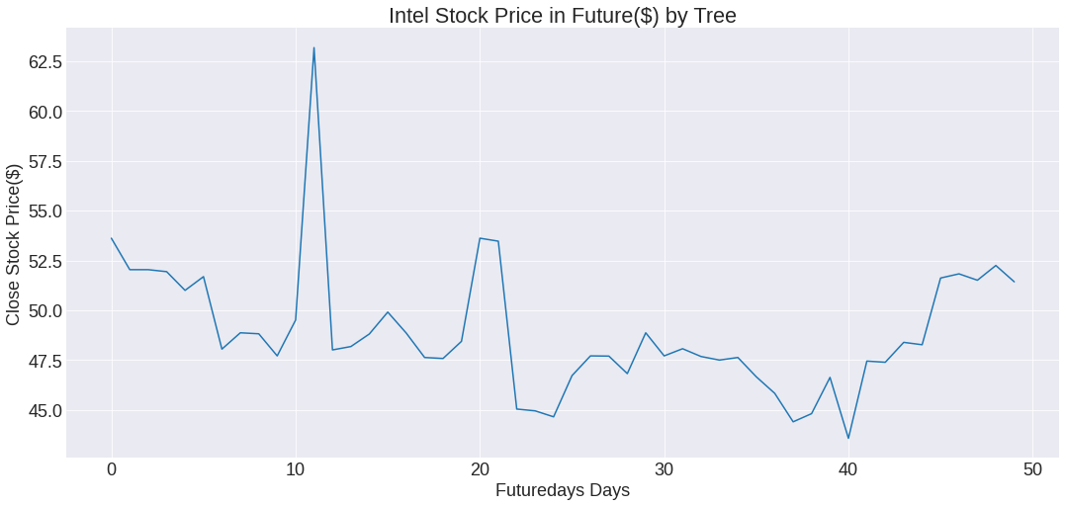
Decision Tree Model
This graph contains only the predicted values which was predicted using Decision tree model.
Notes:
These charts are illustration of how our predictions ……. The first chart on the top left indicates…… followed by the….. Our prediction was proven false ……Results of data

Slide 24
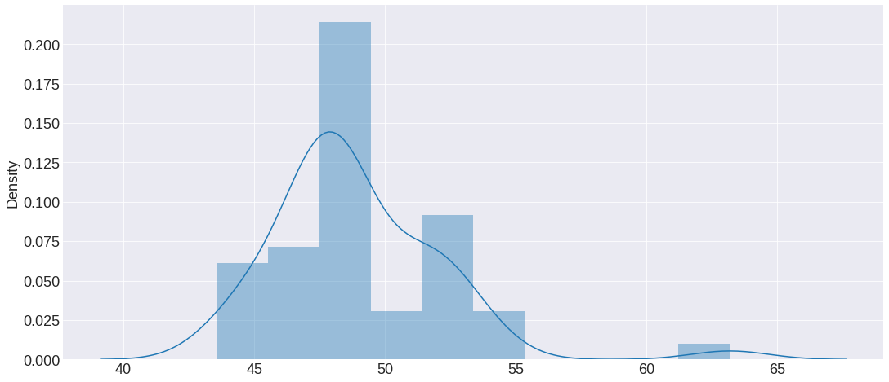
Decision Tree Model
This graph demonstrates the comparison between actual and predicted value using the Decision Tree Model.

Slide 25
Random Forest Strategies

Slide 26
Random Forest for Predicting Buy/Sell
We used the Random Forest Classifier to help us determine if we should buy or sell stocks on any given day, based on the training dataset.
To do this, we needed to create a signal to determine if we should buy or sell on any given day. This signal was then used as the y feature for training the classifier.
We had three different strategies for choosing that signal:
If the adjusted closing price on a given day is greater than the adjusted close on the previous day we added a signal to buy
If the 50 day moving average on a given day is greater than the 200 day moving average on that day we added a signal to buy
If the exponential moving average on a given day was greater than the ALMA on that day we added a signal to buy

Slide 27
Random Forest – Strategy 1

Slide 28
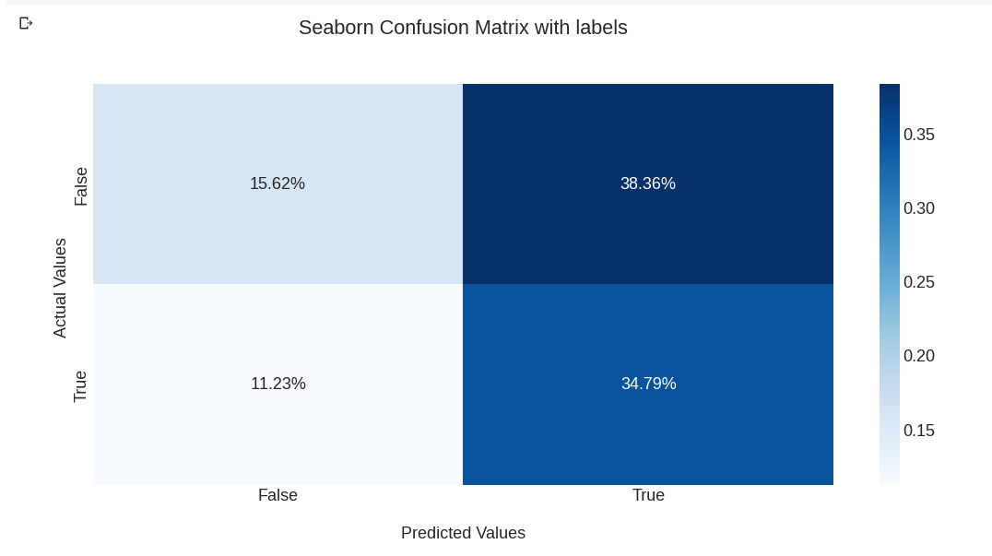
Random Forest – Strategy 1

Slide 29
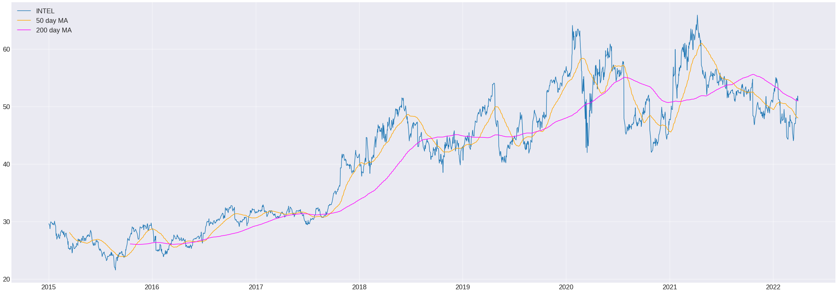
Random Forest – Strategy 2

Slide 30
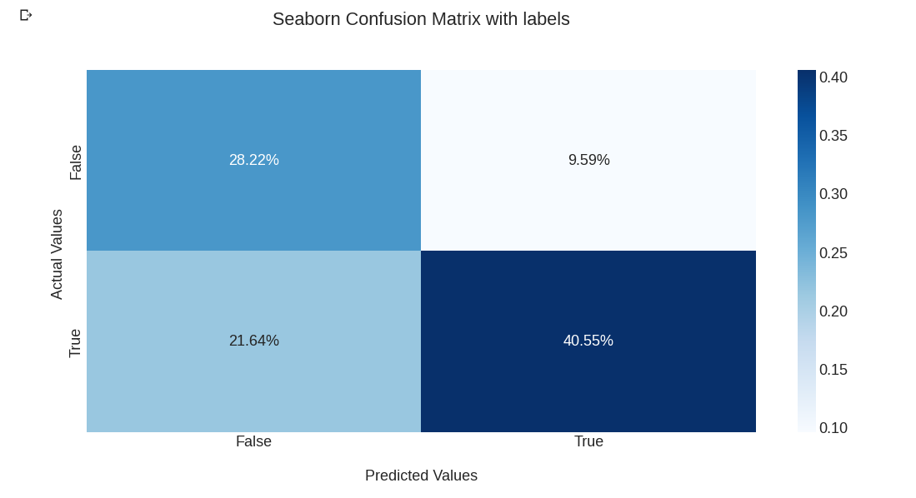
Random Forest – Strategy 2

Slide 31
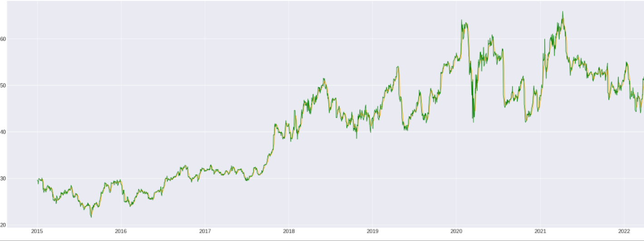
Random Forest EMA > ALMA

Slide 32
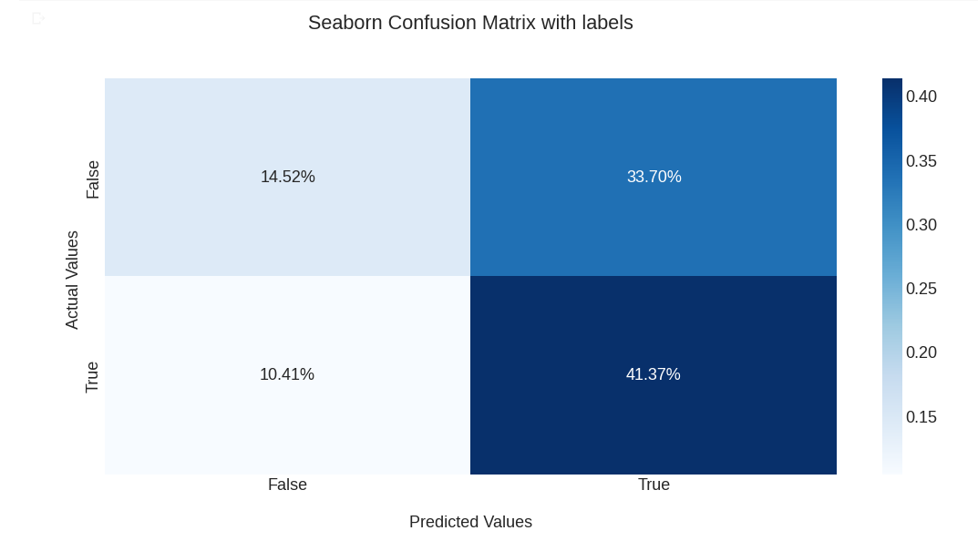
Random Forest – Strategy 3

Slide 33
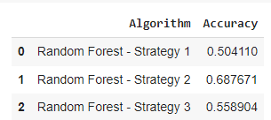
Results

Slide 34
Conclusion
Upon our research the team discovered that the models that were using to forecast the values of the intel stock are not 100% accurate. We tried these models on other stocks and the accuracy were similar to the Intel stocks. Obtaining an accurate stock price prediction is extremely challenging because of multiple factors such as politics, global economic events conditions, and unexpected events within a company. A positive take on the models that we used is that they can eliminate certain factors that can make it easier for a more accurate decision on a stock value.

Slide 35
THANK YOU

